Slide 1
CMPT 481 Presentation
IDK Pro

Slide 2
Project Overview
Motivation
DeviantArt is an art sharing website
Hosts over 325 million pieces of art
Amount of content and current design makes it hard to view the art
Current design does not allow users to view multiple pieces in a streamlined way
Takes users to another page to view the art, leading to loss of scrolling position
Or users can create multiple tabs to view the art which slows down browsers
Notes:
Katie

Slide 3
Project Overview
Objectives
Create a more convenient way to browse through the art
Allow users to view multiple pieces of art at a time
Allow users to store art in an easily accessible area for later viewing
Main Implementations
A screen overlay for viewing the art
A queue that users can add images to and remove them from as they browse
Notes:
Katie

Slide 4
Design Approach
Low-fidelity Prototyping
Paper prototype
Focused on the interaction with the queue
Had space for multiple pieces of art and how the browsing headers would appear
Limited pieces that could be added or removed from the queue, and could be viewed in the queue or individually
Results of usability inspection
Found new concerns that we hadn’t initially considered
i.e. Additions of a help and clear button
Overall we were able to confirm that the design was suitable with minor additions and changes
Notes:
Halle

Slide 5
Objectives of Medium-Fidelity prototyping
Functionality of Browsing
View individual art in a screen overlay
Retain scroll position of the browser when art is viewed
Add art to the queue
Functionality of the Queue
Removing art
Help button for users
Clear button to remove all art from the queue
View art through the queue
Retain scroll position of the browser when art is viewed
Notes:
Halle

Slide 6
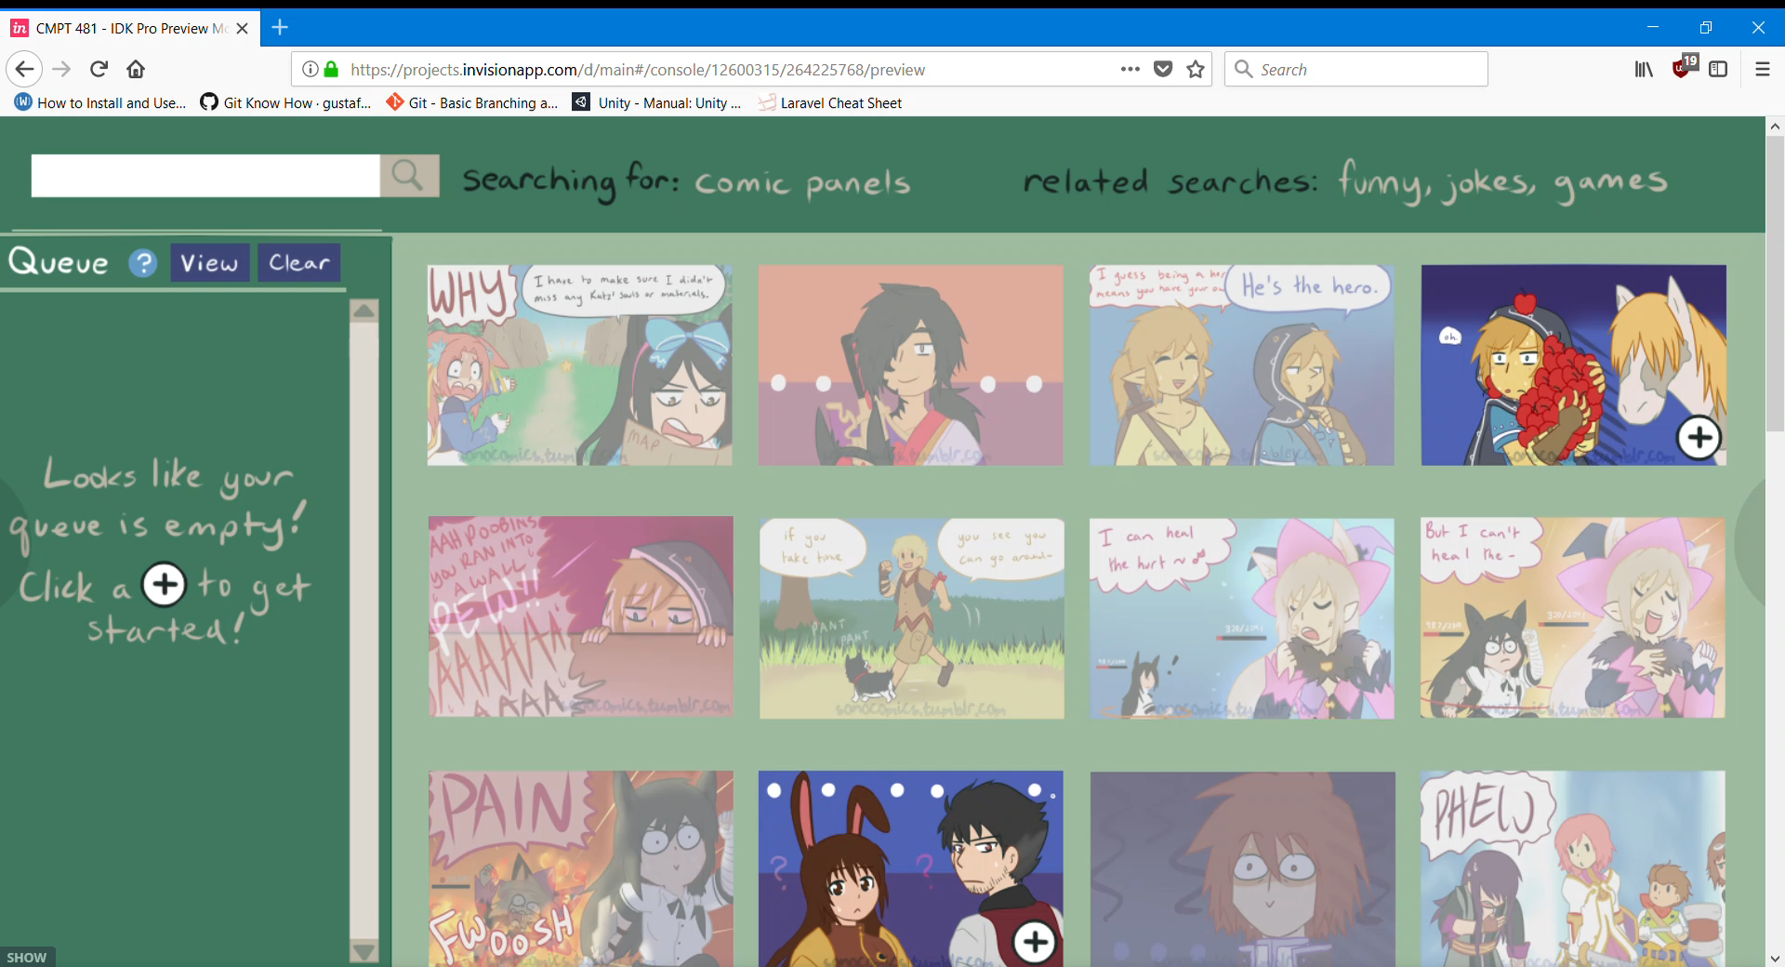
Notes:
Kasey

Slide 7
Rationale and Approach of Evaluation
Exploration & Questionnaire
Had users explore our system
If users weren’t familiar with DeviantArt we had them explore it first
Then fill out a questionnaire
Why this approach?
Due to the nature of our project, there were no specific user groups
Questionnaire allowed us to sample a larger pool of users
12 users were used to evaluate
Notes:
Jason

Slide 8
Results of Evaluation
Positive responses towards the queue, 66.7% reported they would like to use the queue
Majority of users responded positively to the screen overlay being preferred over going to a separate page to view the art
58.3% reported they would prefer to view multiple pieces of art in the queue, 41.7% preferred a single piece
Overall, whole design was rated positively
Notes:
Kasey

Slide 9
Final Recommendations
Allow users to collapse the queue
Allow users to remove items from the queue while they are viewing the queue
Refine the size of the thumbnails
Adding a queue history function so users can keep track of what they have viewed
Implement some of DeviantArt’s native features
We did not do this for the project because we felt it would take away from our main focus of making the browsing better
Notes:
Jason

Slide 10
Questions?

